Slide 1
ABAP Part II
Lesson 1: Object oriented ABAP

Slide 2
Lesson Objectives
After completing this lesson, participants will be able to understand -
OOPS Concepts
ABAP Objects
Creating & Accessing objects
Constructor
Inheritance
Casting
Interfaces
Events
Exceptions

Slide 3
OOPS Concept
Object-oriented programming, is a problem-solving method in which the software solution reflects objects in the real world.
Benefits of Object-oriented programming are :
Multiple Instances
Encapsulation
Inheritance
Polymorphism
Compatibility
Maintainability

Slide 4
Benefits of Object-oriented programming
Multiple Instances
The ability to create multiple instances of a "class", such as a vehicle, is one of the central attributes of object-oriented languages.
Encapsulation
Encapsulation means that the implementation of an object is hidden from other components in the system, so that they cannot make assumptions about the internal status of the object and therefore dependencies on specific implementations do not arise

Slide 5
Benefits of Object-oriented programming
Polymorphism
Polymorphism (ability to have multiple forms) in the context of object technology signifies that objects in different classes react differently to the same messages.
Inheritance
Inheritance defines the implementation relationship between classes, in which one class (the subclass) shares the structure and the behavior defined in one or more other classes (super classes).
Note: ABAP Objects only allows single inheritance.
Compatibility
ABAP object is true extension of ABAP language. ABAP OOPS statements can be used in procedural ABAP programs. Object themselves can contain classic ABAP statements, Only OOPS concepts that have been proved useful have been included. It has been kept the simplest. There is increased use of type checks.

Slide 6
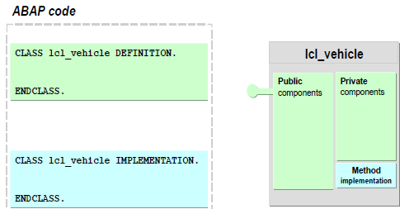
ABAP Objects - Class
A class is a set of objects that have the same structure and the same behavior. A class is therefore like a blueprint, in accordance with which all objects in that class are created.
The components of the class are defined in the definition part. The components are attributes, methods, events, constants, types, and implemented interfaces. Only methods are implemented in the implementation part.
The CLASS statement cannot be nested, that is, you cannot define a class within a class.

Slide 7
Classes
Classes are the central element of object-orientation.
A Class is an abstract description of an object.
Classes are templates for objects.
Defines the state and behavior of the object.
Types of classes
Local classes
Defined within an ABAP program
Can be used only within that program
Global classes
Defined in the class builder SE24
Stored centrally in class library in the R/3 repository
Can be accessed from all the programs in the R/3 system
e.g. CL_GUI_ALV_GRID, CL_GUI_CUSTOM_CONTAINER
Notes:
Defining Local Classes:
A complete class definition consists of a declaration part and, if required, an implementation part.
The declaration part of a class is a statement block that contains the declaration for all components (attributes, methods, events) of the class.
CLASS <class> DEFINITION. ... ENDCLASS.
If you declare methods in the declaration part of a class, you must also write an implementation part for it. The implementation part of a class contains the implementation of all methods of the class.
CLASS <class> IMPLEMENTATION. ... ENDCLASS.

Slide 8
ABAP Objects - Attributes
Attributes describe the data that can be stored in the objects of a class.
Attributes can have any kind of data type:
C, N, I, P, ..., STRING
Dictionary types
User-defined types
TYPE REF TO defines a reference to an object, in this case “r_car”
Public attributes
Can be viewed and changed by all users and in all methods
Direct access
Private attributes
Can only be viewed and changed from within the class
No direct access from outside the class
Notes:
Attributes are internal data fields within a class that can have any data type.
The state of an object is determined by the contents of its attributes.
Two types of attributes:
Instance Attributes
Define the instance specific state of an object.
Declared using DATA statement.
Static Attributes
Define the state of the class that is valid for all instances of the class.
Exist once for each class.
Declared using CLASS-DATA statement.

Slide 9
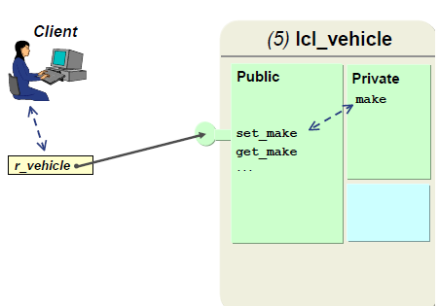
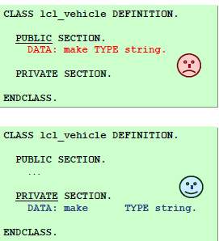
ABAP Objects - Attributes
Accessing private attributes :You can access an object's private attributes using public methods, which in turn output this attribute or change it.

Slide 10
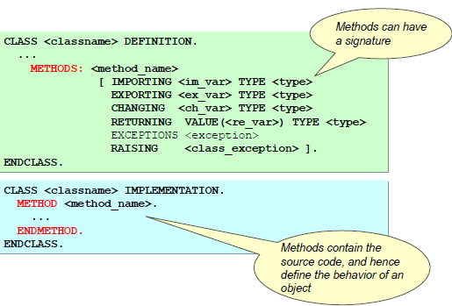
ABAP Objects - Methods
1. Methods are internal procedures in classes that determine the behavior of an object. They can access all attributes in their class and can therefore change the state of an object.
2. Methods have a parameter interface (called signature) that enables them to receive values when they are called and pass values back to the calling program.
Notes:
Methods are internal procedures in a class that define the behavior of an object.
Methods have a parameter interface with which user can supply them with values when calling them and receive values back from them.
Two types of methods:
Instance Methods
Declared using METHODS statement.
Can access all the attributes and methods of the class.
Static Methods
Declared using CLASS-METHODS statement.
Can access only the static attributes and methods of the class.

Slide 11
Methods and Visibility
Public methods
Can be called from anywhere
Private methods
Can only be called within the class
Notes:
You can divide the declaration part of the class definition into visibility sections.
Each of the class component must be assigned to one of the visibility sections.
Three visibility sections are:
Public Section
All the components declared here are accessible to all users and the methods of that class and classes that inherit from it.
2. Protected Section
All of the components declared here are accessible to all methods of that class and classes that inherit from it.
3. Private Section
All of the components declared here are only visible in the methods of that class.

Slide 12
Demo: Create a class with instance attributes and instance methods

Slide 13
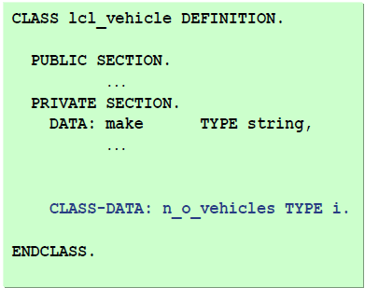
Instance attributes and Static attributes
Instance attributes
One per instance
Statement: DATA
Static attributes
Only one per class
Statement: CLASS-DATA
Also known as class attributes

Slide 14
Instance method and Static method
Instance methods
Can use both static and instance components in their implementation part
Can be called using an instance
Static methods
Can only use static components in their implementation part
Can be called using the class

Slide 15
Demo: Create a class with static attributes and static method

Slide 16
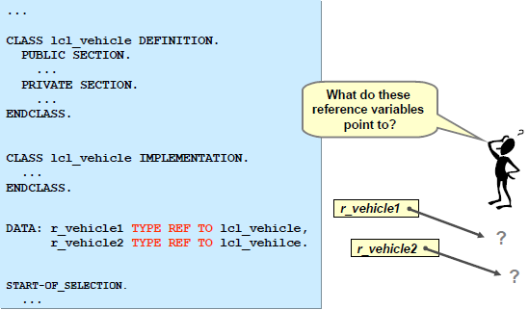
Reference Variable
A reference variable acts as a pointer to an object.
DATA: R_VEHICLE1 TYPE REF TO LCL_VEHICLE.
Declares a reference variable that acts as a pointer to an object

Slide 17
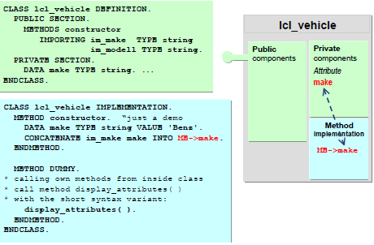
Reference Variable ME
You can address the object itself within instance methods using the implicitly available reference variable me.
Description of example: In the constructor, the instance attribute make is covered by the locally defined variable make. In order to still be able to address the instance attribute, you need to use me.

Slide 18
Demo: Create a class with Reference variable Me

Slide 19
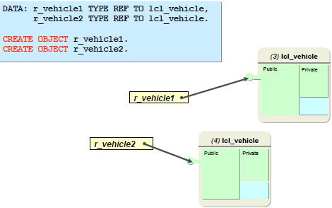
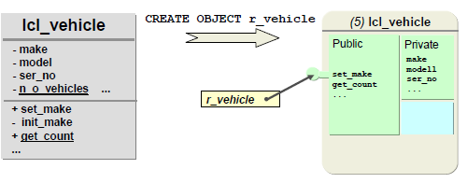
Creating and Accessing Objects
An object is a section of source code that contains data and provides services
Objects are created using the CREATE OBJECT statement
Objects can only be created and addressed using reference variables
An object is a section of source code that contains data and provides services.
Notes:
Objects are instances of classes.
Each object has a unique identity and its own attributes.
A class can have any number of objects (instances).
To access an object from an ABAP program, we use object references.
Defined using <ref> TYPE REF TO <class>.
Created using CREATE OBJECT <ref>.
Accessing object attributes <ref>–><attribute>.
Accessing class (static) attributes <class>=><attributes>.
Accessing object methods CALL METHOD <ref>-><method>.
Calling class (static) methods CALL METHOD <class>=><method>.

Slide 20
Accessing Attributes and Method
Instance methods are called using
CALL METHOD <reference>-><instance_method>.
Static methods (also referred to as class methods) are called using CALL METHOD <classname>=><class_method>.
If you are calling a static method from within the class, you can omit the class name.
Static attributes are accessed using <classname>=><class_attribute>
instance attributes are accessed using
<instance>-><instance_attribute>
=> and -> are the component selectors

Slide 21
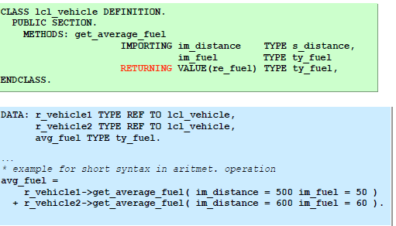
Functional Method
Methods that have a RETURNING parameter are described as functional methods. These methods cannot have EXPORTING or CHANGING parameters, but has many (or as few) IMPORTING parameters and exceptions as required. You can only do this for a single parameter, which additionally must be passed as a value.

Slide 22
Demo: Create a class with Functional Method

Slide 23
Constructor
The constructor is a special instance method in a class with the name constructor.
Each class can have one constructor.
The constructor is automatically called at runtime within the CREATE OBJECT statement.
If you need to implement the constructor, then you must define and implement it in the PUBLIC SECTION.
You cannot normally call the constructor explicitly
Special method for creating objects with defined initial state
Only has IMPORTING parameters and EXCEPTIONS
Is executed only once per instance
Notes:
Constructors are special methods called automatically by the system to set the starting state of a new object or class.
Constructors are called when the class is instantiated.
Two types of constructors:
Instance Constructors
Declared using METHODS CONSTRUCTOR.
Used to initialize instance attributes.
Static Constructors
Declared using CLASS-METHODS CLASS_CONSTRUCTOR.
Used to initialize static attributes.
Constructors are implemented in the implementation part using
METHOD <method>.
...
ENDMETHOD

Slide 24
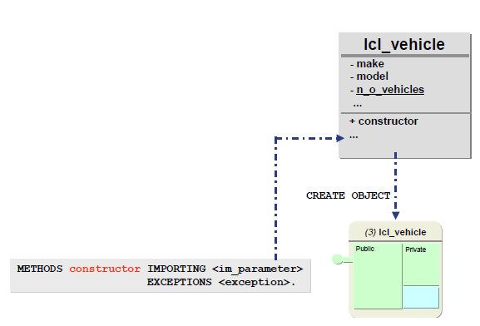
Constructor

Slide 25
Demo: Create a class with Constructor

Slide 26
Static Constructor
The static constructor is a special static method in a class with the name class_constructor. It is executed precisely once per program.
The static constructor of a class <classname> is called automatically when the class is first accessed, but before any of the following actions are executed:
Creating an instance in the class using CREATE OBJECT <obj>, where <obj> has the data type REF TO <classname>
Addressing a static attribute using <classname>=><attribute>
Calling a static attribute using CALL METHOD <classname>=><classmethod>
Registering a static event handler method using SET HANDLER <classname>=><handler_method> FOR <obj>
Registering an event handler method for a static event in class <classname>.
The static constructor cannot be called explicitly.

Slide 27
Demo: Create a class with Static Constructor

Slide 28
Demo: Global Class creation through SE24

Slide 29
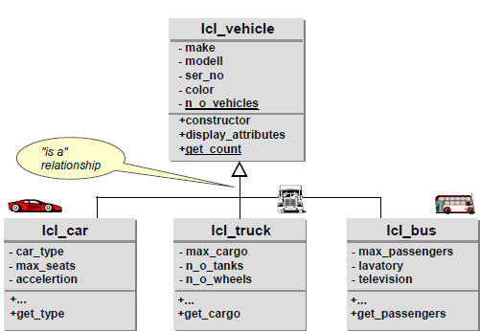
Inheritance
Inheritance is a relationship, in which one class (the subclass) inherits all the main characteristics of another class (the superclass). The subclass can also add new components (attributes, methods, and so on) and replace inherited methods with its own implementations.
The inheritance relationship is often described as an "is a" relationship:
A truck is a vehicle

Slide 30
Inheritance
Single Inheritance
ABAP Objects only has single inheritance.
A class may only have one direct superclass, but it can have more than one direct subclass. The empty class OBJECT is the root node of every inheritance tree in ABAP Objects.

Slide 31
Inheritance
Relationship between Super class and Sub class
Common components only exist once in the superclass
New components in the superclass are automatically available in subclasses
Amount of new coding is reduced ("programming by difference")
Subclasses are extremely dependent on superclasses
"White Box Reuse":
Subclass must possess detailed knowledge of the implementation of the superclass

Slide 32
Inheritance
Normally the only other entry required for subclasses is what has changed in relation to the direct superclass. Only additions are permitted in ABAP Objects, that is, in a subclass you can "never take something away from a superclass". All components from the superclass are automatically present in the subclass.

Slide 33
Inheritance
The REDEFINITION statement for the inherited method must be in the same SECTION as the definition of the original method.
If you redefine a method, you do not need to enter its interface again in the subclass, but only the name of the method.
In the case of redefined methods, changing the interface (overloading) is not permitted; exception: Overloading is possible with the constructor.
Within the redefined method, you can access components of the direct superclass using the SUPER reference.
The pseudo-reference super can only be used in redefined methods.

Slide 34
Demo: Inheritance

Slide 35
Casting
Up-Cast (Widening Cast)
The assignment of a subclass instance to a reference variable of the type "reference to superclass" is described as a Widening cast. As the target variable can accept more dynamic types in comparison to the source variable, this assignment is also called widening cast.
What is a Widening cast used for?
A user who is not interested in the finer points of cars, trucks, and busses (but only, for example, in the fuel consumption and tank gauge) does not need to know about them. This user only wants and needs to work with (references to) the lcl_vehicle class. However, in order to allow the user to work with cars, busses, or trucks, you generally need a narrowing cast.

Slide 36
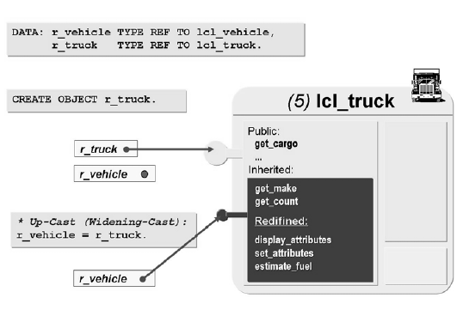
Widening Cast

Slide 37
Demo: Inheritance – Widening cast

Slide 38
Casting
Down-cast (Narrowing Cast)
The Narrowing cast logically represents the opposite of the widening cast. The narrowing cast cannot be checked statically, only at runtime. The Cast Operator ?= (or the equivalent MOVE ... ?TO…) must be used to make this visible.
As the target variable can accept less dynamic types after the assignment, this assignment is also called narrowing cast.
What is a Narrowing cast used for?
The client, the car rental company wants to execute a function for specific vehicles form the list (vehicle_list). For example, the client wants to ascertain the truck with the largest cargo capacity. However, not all vehicles are in the trucks list, it also includes references to cars and busses.

Slide 39
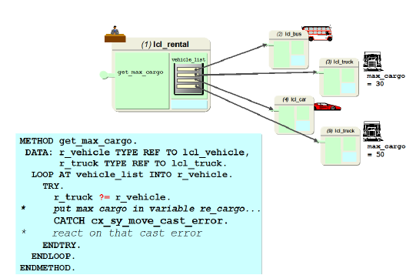
Casting
With this kind of cast, a check is carried out at runtime to ensure that the current content of the source variable corresponds to the type requirements of the target variables. If it is, the assignment is carried out. Otherwise, an exception of the error class CX_SY_MOVE_CAST_ERROR is raised.

Slide 40
Demo: Inheritance – Narrowing cast

Slide 41
Interfaces
Interfaces only describe the external point of contact of a class (protocols), they do not contain any implementation.
Interfaces are usually defined by a user. The user describes in the interface which services (technical and semantic) it needs in order to carry out a task.
The user never actually knows the providers of these services, but communicates with them through the interface.
In this way the user is protected from actual implementations and can work in the same way with different classes/objects, as long as they provide the services required. This is known as polymorphism with interfaces.
Notes:
Interfaces exclusively describe the external point of contact of a class, but they do not contain their own implementation part.
Interface has only declaration part, implemented in the public section of classes.
Interfaces do not have visibility section.
A class can implement any number of interfaces and an interface can be implemented by any number of classes.
Interface resolution operator enables to access interface components using an object reference belonging to the class implementing the interface.

Slide 42
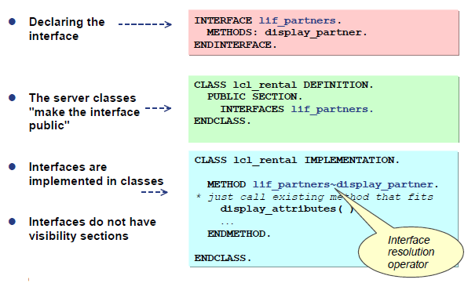
Interfaces

Slide 43
Demo: Interfaces

Slide 44
Exceptions
Exception refer to a situation that arises while an ABAP program is being executed, where there is no point in continuing to run the program in the normal way.
Class-based exceptions are raised either using the ABAP statement RAISE EXCEPTION or by the ABAP runtime environment.
If a class-based exception occurs, the system interrupts the normal program flow and tries to navigate to a suitable handler. If it cannot find a handler, a runtime error occurs.
The use of class-based exceptions is not limited to object-oriented contexts. Class-based exceptions can be raised and handled in all ABAP processing blocks.

Slide 45
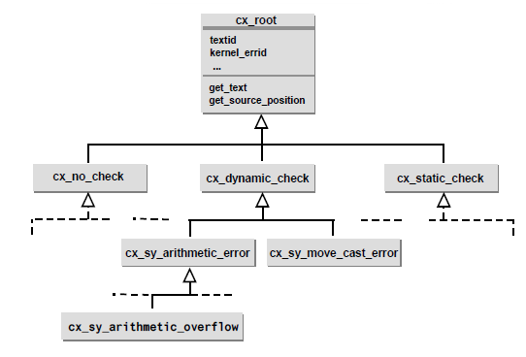
Exceptions Classes: Inheritance hierarchy

Slide 46
Exceptions Classes: Inheritance hierarchy
The root class CX_ROOT contains two predefined methods that are inherited by the other classes.
The GET_SOURCE_POSITION method returns the program name, include name (if relevant), and line number in the source code where the exception occurred.
The GET_TEXT method returns an exception text of a class in the form of a string.
You can assign several texts to each class. You can then specify which text is to used when an exception is raised by passing an identifier to the IMPORTING parameter TEXTID of the instance constructor.
All exception classes inherit the KERNEL_ERRID attribute from CX_ROOT. This attribute contains the name of the appropriate runtime error if the exception was raised by the runtime environment - such as COMPUTE_INT_ZERODIVIDE if the program tries to divide by zero

Slide 47
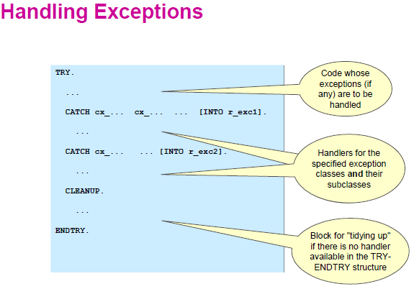
Handling Exceptions

Slide 48
Handling Exceptions
The TRY block contains the application code that is to handle the exceptions.
If an exception occurs in the TRY block the system searches first for a CATCH statement (which will handle the exception) in the same TRY-ENDTRY structure and then step by step outwards in all the enclosing TRY-ENDTRY structures.
A CATCH block contains the exception handler that is executed if a specified exception has occurred in the TRY block in the same TRY-ENDTRY structure.
In some cases, the system cannot find a handler for an exception within a specific TRY-ENDTRY structure but the exception is handled in a surrounding TRY-ENDTRY structure or passed along to a calling program. If this occurs, a CLEANUP block is executed before leaving the TRY-ENDTRY structure.

Slide 49
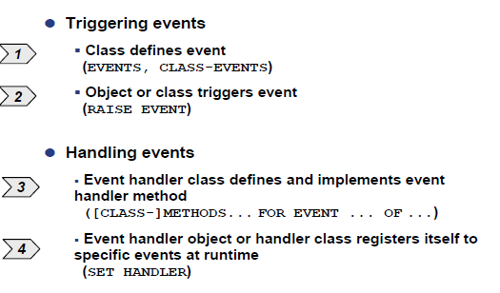
Events
By triggering an event, an object or class announces a change of state, or that a certain state has been achieved.

Slide 50
Events
At the moment of implementation, a class defines its :Instance events (using the EVENTS statement) Static events (using the CLASS-EVENTS statement)
Classes or their instances that receive a message when an event is triggered at runtime and want to react to this event define event handler methods. Statement: [CLASS-]METHODS <handler_method> FOR EVENT <event> OF <classname>.
These classes or their instances are registered to one or more events at runtime. Statement: SET HANDLER <handler_method> FOR <reference>. (for instance events) SET HANDLER <handler_method>. (for static events)
A class or instance can trigger an event at runtime using the RAISE EVENT statement.

Slide 51
Events
Both instance and static events can be triggered in instance methods. Only static events can be triggered in static methods.
Events can only have EXPORTING parameters which must be passed by value.
Triggering an event using the statement RAISE EVENT has the following effect:
1.The program flow is interrupted at that point
2.The event handler methods registered to this event are called and processed
3.Once all event handler methods have been executed, the program flow continues

Slide 52
Events
Registering for an event
When an event is triggered, only those event handler methods are executed that have, by this point, registered themselves using SET HANDLER.
You can register an event using ACTIVATION 'X', and deregister it using ACTIVATION space. If you do not specify ACTIVATION, then the event registers (default behavior).
You can register several methods in one SET HANDLER statement: SET HANDLER <ref_handle1>-><handler_method1> ... <ref_handleN>-><handler_methodN> FOR <ref_sender> | FOR ALL INSTANCES

Slide 53
Events
Registration/De registration: Handler Tables
Every object that has defined events has an internal table, the handler table. All objects that have registered for events are entered in this table together with their event handler methods.

Slide 54
Demo: Events

Slide 55
Summary
In this lesson, you have learnt:
OOPS Concepts
ABAP Objects
Creating & Accessing objects
Constructer
Inheritance
Casting
Interfaces
Events
Exceptions

Slide 56
Review Question
Question 1: _______ do not contain implementation.
Question 2: _____means that the implementation of an object is hidden from other components in the system.

